Slide 1
Modern Engineering – DevOps Introduction

Slide 2

Strategic alliance delivering cloud and digital transformation
Expertise in leading clients’ cloud and digital transformation
Deep industry knowledge and specialization
Capacity to scale to the largest enterprise needs, including the majority of the Fortune 100
Most dedicated and invested SI on the Microsoft platform
Dedicated to being best cloud and digital innovator with Microsoft technologies
Committed to partnering across Microsoft ecosystem
Comprehensive, enterprise-ready intelligent cloud platform
Reinventing productivity and business processes
Pioneering personal computing technologies like HoloLens

Slide 3
Our standard Approach
Discover
Define
Refine
Plan
Future Activities
Working Group Activities
Working Group Review
Working Group Verification
Transformation
Conduct Surveys
Executive Alignment / Kick-off
Align w/Strategic Priorities
Desired State RoadMap
Engagement
Approach
Implementation Rollout
Current State Workshops
Conduct Interviews
Stakeholder Engagement
Outputs
Leadership & Working Group together
Working Group Discussions
Working Group Review
Working Group Verification
Team Survey Report
​Maturity Assessment
Current State
Recommended Desired State Roadmap (based on strategic priorities)
1 to 2-hour meeting

Slide 4
Co-Create technical spikes themes
Feedback Loop
Branching Strategy
Code Quality
Automated Testing
Continuous Integration
Continuous Delivery
Continuous Deployment
Continuous Improvement
Architecture guidelines
Dependency Management
Versioning and coding standards
Security and compliance
Modernisation assessments
Tool Selection
Collaboration and integration
Infrastructure as Code
Documentation as Code
Data Available
Evaluate Improvement / reiterate
People Processes and tools
Feedback Loop
Data Available
Branching Strategy
Code Quality
Automated Testing
Continuous Integration
Continuous Delivery
Continuous Deployment
Continuous Improvement
Architecture guidelines
Dependency Management
Versioning and coding standards
Security and compliance
Modernisation assessments
Tool Selection
Collaboration and integration
Infrastructure as Code
Documentation as Code
Evaluate Improvement / reiterate
People Processes and tools

Slide 5
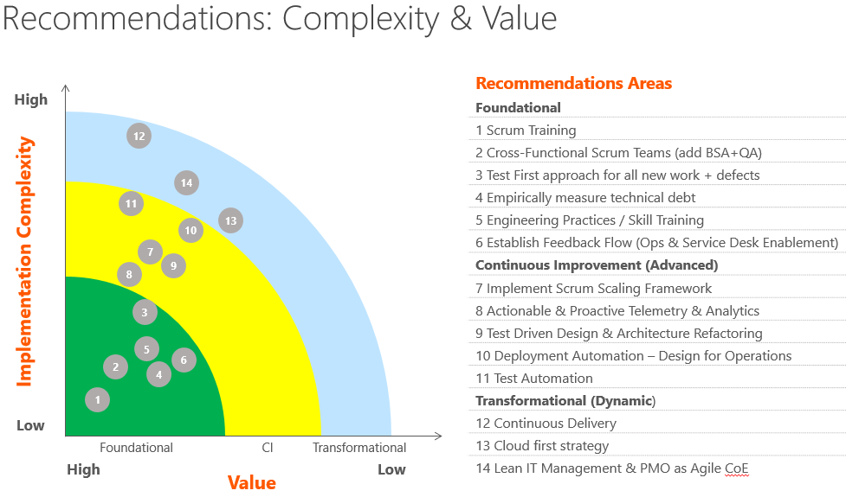
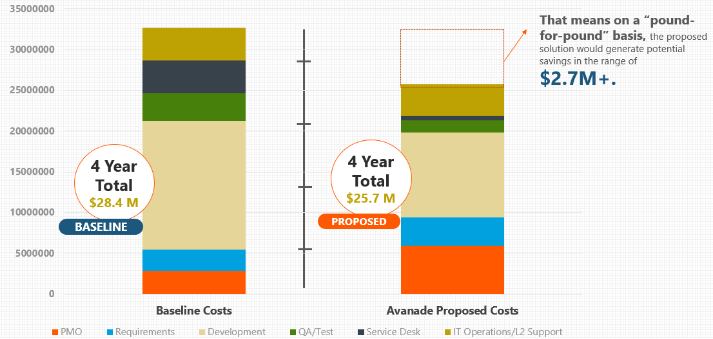
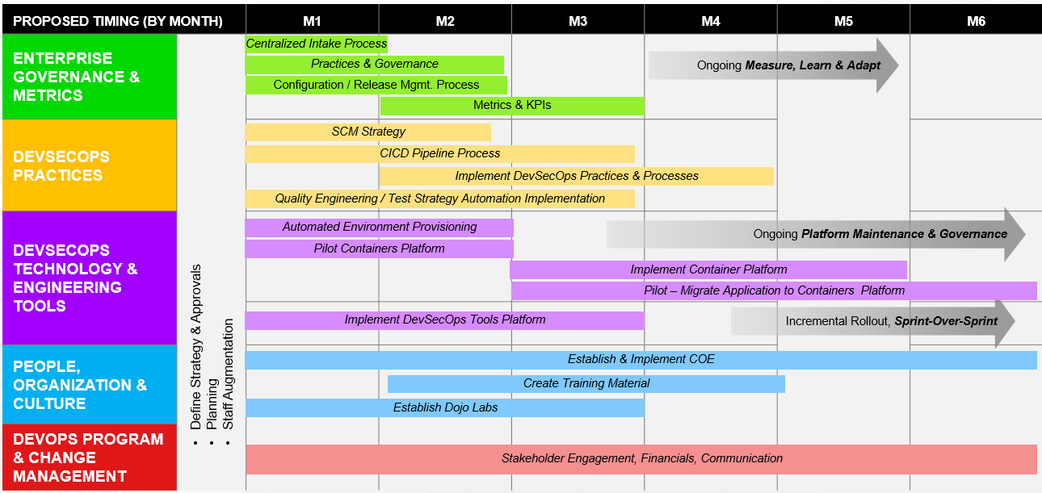
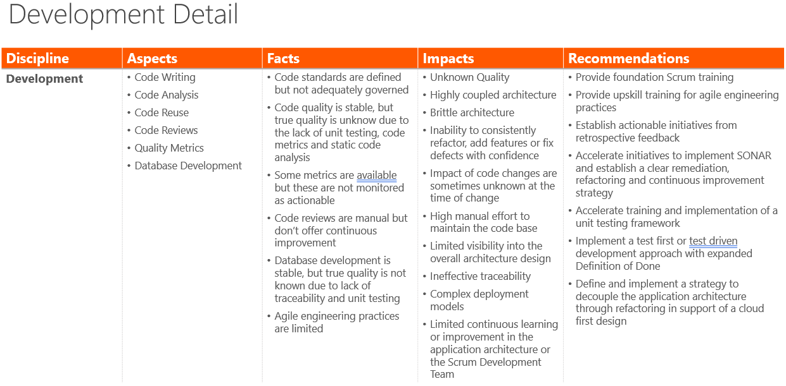
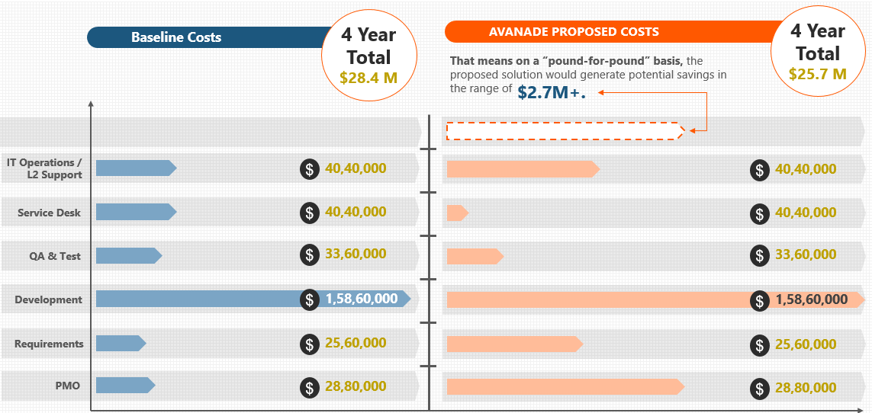
Detailed Plan – Week 4 – Outcomes
In the last week all the documents will be finalized and presented to the working groups and the stakeholders.
Sample Assessment
Sample Business Case Analysis
Sample Roadmap

Slide 6



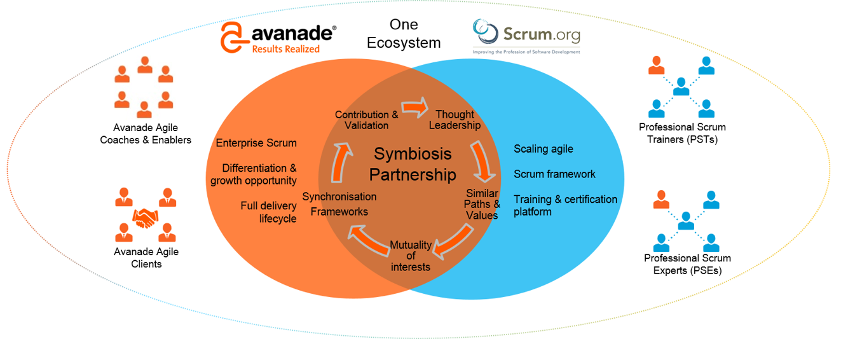
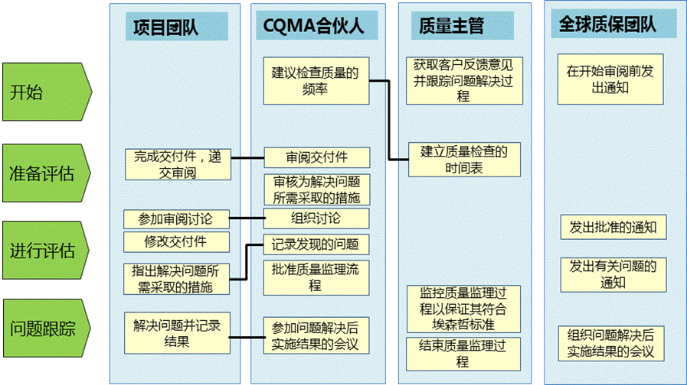
Quality Assurance and Agile Management of Quality Management System
Agile Management Certification (scrum.org)
Responsible for customers, to provide customers with high-quality system consulting and development services is Avanade's corporate philosophy. As a global management and technical consulting firm, Avanade implements quality management principles through sound quality management methods, including:
Quality management concept: unique ExPECT principles in business integration methodology; ExPECT model identifies five key components of quality management: expectation, planning, execution, inspection and modification
Quality control means: customer quality management evaluation CQMA process.
scrum.org Special Strategic Partnership
12
200+
Professional
Scrum
Trainers (PST)
Only 125exist worldwide
Certified in
Professional
Scrum Master (PSM)
Industry recognized
100+
Certified in
Professional
Scrum Developer (PSD)
Highly selective

Slide 7
Team situation and scale of implementation of agile management
Over
10
Satisfactory
Year
Suite or custom
development software
Agile implementation experience
Large or distributed application environments
1,300+
Established a professional Agile Academy
Agile implementation of certification
Professional staff
7
Role-based
Training courses
Over
3,800
Average Agile Team
Scale achieved
Professional agile practitioners worldwide
30+
People
600+
Customer team
Notes:
As Agile advocates, Agile can bring business
Transparency:
We all know what needs to be done and why
We all know how to do it
We all know what's going on and what's going on
Review:
High level of collaboration between operations and IT departments
Review, feedback and adjustment become the normal pace of project implementation
Improved project stakeholder satisfaction
Adaptation:
What the market needs, what should we do
The market needs us to do what we should do
The value of the market reflects the value of the project
Impact on the project team
Spontaneous organization and co-responsibility of agile advocacy enhance teamwork and team spirit
Market value reflects the sense of achievement and responsibility that inspires the team
ALM tools and best practices help teams improve the quality and efficiency of their work

Slide 8



Quality performance of similar projects
Client
Industry
Region
Technology
Team size
Cars, Internet
United Kingdom
NET,ALM
17
A mobile phone manufacturer
High tech
Finland, China
SAP,Java,. NET
150
A chemical company
Chemical industry
United States, China
SAP . NET, etc
187
Telecommunications
Australia
NET
40
Cars
United States
NET
9
A large public welfare organization
Public services
United States
Dynamics CRM,MOSS
8
An online travel service
Internet
United Kingdom
E-commerce,ATG
40

Slide 9
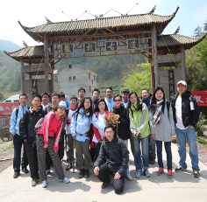
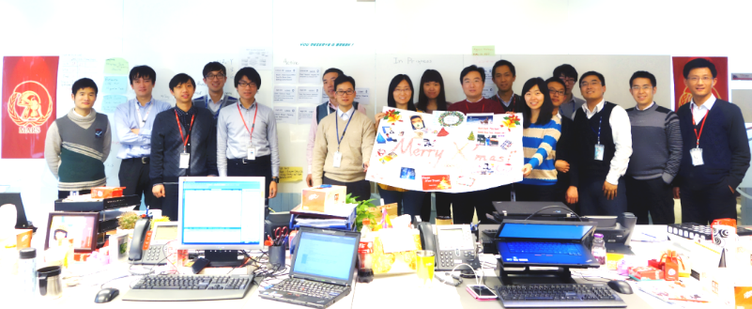
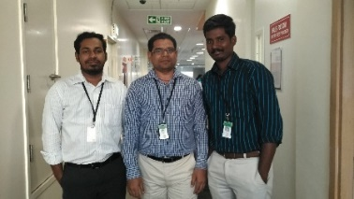
Case 1: Agile implementation of a Global Famous Chemical Company - Project fundamentals
The project support center is responsible for the implementation and support of various business systems in the global IT. Avanade has >20 years of long-term cooperation with the company to provide strategic management consulting and information system services to customers.
Project implementation methodology (PDM) and ITIL standards based on waterfall model are applied to IT project implementation and system maintenance.
Since 2009, in order to adapt to the company's business transformation and digital strategy and improve market competitiveness, the company has planned and implemented a series of activities, such as Digital transformation, improving reliability, improving user experience, etc., including Scrum methods advocated to improve project agility and simplifying PDM promotion.
More than 20 Scrum teams are distributed in various regions of the world, providing project implementation for finance, human resources, logistics, transportation, EH&S and other business departments.
Six Scrum teams in China serve the company's agricultural, logistics, transportation, EH&S 、 marketing and information services departments, with an average project implementation cycle of about 10 months and tens of thousands of hours of project work per year.

Slide 10
Case 1: Agile Implementation - Implementation Plan for a Global Famous Chemical Company
Scope of implementation: according to the agile project suitability selection scheme, select in a certain agricultural and chemical department of the company in a number of IT projects, and finally gradually extended to the entire IT project support center.
Management process:
Project role:
Core Scrum team (3~9):
Product Manager (Product Owner): from the business unit of the company
Agility Master (Scrum Master): Avanade
Development team (Development Team): Avanade and other suppliers
Project stakeholders (Stakeholders): system users, system managers and system service personnel.
Project Manager (Project Manager): from PMO company
Architect (Architect Specialist): Corporate IT
Infrastructure Engineer (Infrastructure Engineer): shared team members, Avanade and other suppliers
Agile Scrum
Project project (Opportunity Analysis)
Project preparation (Planning)
Operations and maintenance (Operation)
System implementation (Implementation)
Project acceptance and closure (Closure)

Slide 11
Case 1: Agile implementation by Global Famous Chemical Company
Implementation strategy:
Risk analysis and prevention:
Agile development approaches that divide system implementation into small areas and implement it in stages can in themselves significantly reduce project risk
pilot implementation and promotion. According to the characteristics of business requirements, the importance of the project, customer maturity and team maturity, the agricultural chemical department is selected as the pilot.
Project risk projects | Response strategies
Unclear objectives and assessment indicators | Identify project values, vision and evaluation indicators Ensure senior management and project management office support in corporate operations
Project team unfamiliar with agile development | Organize and arrange agile training, knowledge lectures and sharing. Introduction of Agile coaching roles to improve Agile development
PO or stakeholders do not understand Agile development | Organizing Agile Training Certification for Product Managers and Architects
Inadequate Agile infrastructure | Using Avanade Agile Infrastructure to guide the gradual establishment of compliant ecosystems
Virtual teams (different countries/regions) | Minimize team location and improve communication efficiency
Project risk monitoring | ALM tools such as dashboards, reports, etc Ensure that these tools are transparent and accessible to team owners Establish risk and response lists Scrum-of-Scrum for some large projects
Project Communication Gap | Agile meetings, team building, exchange of delegates (virtual teams), etc
Technical risks | Unified technology development platform The introduction of automation such as automated testing, continuous integration (CI) and continuous release (CD) ALM practices

Slide 12
Case 1: Agile implementation by Global Famous Chemical Company
Problems and challenges encountered
Product managers or project stakeholders not participate enough that project work can not receive timely feedback and generate dependency delay
Dependence on shared teams, such as infrastructure teams, DB teams, etc
Time zone differences, Sprint planning and review often take more time, and team members complain
Language barriers, low communication efficiency or misunderstanding, and cultural differences can lead to communication problems
Technology or architecture is immature and requires additional training or evolution
Non-transparent create antagonism between the development team, the PO or project stakeholders and undermine mutual trust
Differences between team members can not be resolved in time
Team project time is not guaranteed, some teams do both project and operation
Team stability issues
Implementation experience:
A deep understanding of the basics, processes and values of agility is essential
Early involve in the project, PO and business people are trained to understand the characteristics of agile projects
Commitment to product manager project time input from start
The role of Agile Masters needs to play the role
Trust between development team， PO, project stakeholders should be ongoing
Application of tools and best practices can greatly improve efficiency, such as ALM tools, automation tools, etc
Familiar with the DevOps concept, the operation and maintenance team as one of the important stakeholders
Commitment
Incentives
Focus
Agile
Respect
Transparency

Slide 13
Case 1: Agile implementation by Global Famous Chemical Company
Value to business (6 agile Scrum teams in China)
20 projects completed yearly
95 %of projects were completed within expected time and budget
Greatly improved business sector satisfaction, such as meet most of the requirements, improved the user experience
Able to maintenance of +100 production system
The operation and maintenance efficiency is greatly improved and the cost is reduced. As the advice given to the operation and maintenance department while implementing the system design stage,
Team is greatly encouraged, more than 50 ideas are presented and at least 15 ideas are effectively implemented.
New technologies have also been quickly applied, such as cloud computing, mobile application development and new user experiences
Compared to traditional waterfall projects,
Less project time (PDM：>2 months, Scrum ：<1 month)
Significantly reduced the number of unnecessary documents (PDM ： dozens, Scrum: several)
Simplified approval process (PDM: implemented after repeated validation Scrum : confirmed during implementation)
Increased trust between business and application development departments

Slide 14
Case Study 2 : Gov. agency of XXX– the aspiration
Transformation Objectives
Strategic Priorities
Anticipate Needs, co create and customize Solutions
Collaborate and co create with the community
Customize information, service delivery & compliance
Connect Digitally
Be 100% digital
Integrate seamlessly
Build smart and agile IT systems
Use Data Intelligently
Think data first
Embed Analytics in processes and systems
Gain insights for smarter decision making
Build an adaptable & high-performing workforce
Inculcate culture of innovation & experimentation
Build capabilities to excel in a digital workplace
Collaborate in cross Functional teams
Customer Centred Experience.
Shared Values.
Smart Digitral Workplace.
Empowered and future ready people.
Socially Responsible Community
Being Nimble

Slide 15


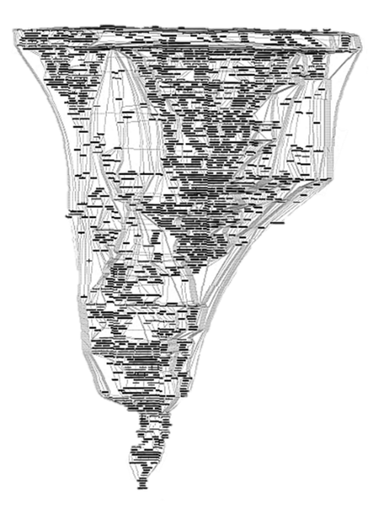

Case Study 2: Gov. agency in XXX – the Challenge
Agility and Scalability Challenge
The core processing system is impacting the speed of change
16+ years old system, built originally on .NET 1.0, now on .NET 4.5 (using DB2 on mainframe, FICO rules engine, TIBCO messaging, etc.)
Ballooned into 26+ millions lines of code
Heavily batch oriented, monolithic architecture
Releasing new features is very expensive and takes a lot of time
Employees spend a lot of time processing the information manually while waiting for the system to be updated
Hardware is significantly overprovisioned, to handle the 1 week of peak processing
Unable to fulfil the Nimble vision

Slide 16


Case Study 2: Gov. agency in XXX – the Solution
Highlights
Taxes, the lifeblood of XXX, will flow through Azure!
Decoupled architecture will allow to roll out changes rapidly
Azure will enable XXXX to tap into innovative technologies quickly
Approach
Main goal: Business Agility
Based on the Digital Decoupling, Modern Engineer Approach and Modernization Offering
Progressive modernization (no big bang) with an extended co-existence period
Solution Features
Hybrid Architecture: Azure + Azure Stack
Cloud Native: 95% PaaS & SaaS
Microservices + Micro Frontend
Event Based Architecture
Infrastructure as Code, Azure Landing zones using Terraform
DevSecOps
Zero Trust Security
Microsoft + Open Source Technologies: .NET Core, Kubernetes, Istio, Kafka
D365 CRM
Internal Portal Spoke
External Portal Spoke
Micro Services Spoke
Hub
DevOps
Common
Microsoft Azure
XXX Commercial Cloud
Azure Stack Hub
On-Prem Spoke
Legacy Systems
* Harvested internal accelerator available on the InnerSource!

Slide 17
Q & A

